Slide 1
Fraud Transaction Detection
Zengxiaoran Kang, Kazy Atausha

Slide 2
Table of Contents
Objectives
Promote a statistical model that can make binary decisions on whether transactions are fraudulent based on key characteristics.
Importance of Study
Data Description
Exploratory Analysis
Random Forest
Single decision tree attempt
Result
Logistic Regression
Variable transformation
Variable selection with Lasso and RFE
Result

Slide 3
Importance of Study
According to the 2021 Identity Fraud Study released by Javelin Strategy & Research, total combined fraud losses climbed to $56 billion in 2020.
A recent study from Juniper Research stated that businesses in eCommerce, airline ticketing, money transfer, and banking services would have an expected loss over $200 billion between 2020 and 2024.

Slide 4
Data Description
Features are:
Time
Payment type
Documented transaction amount
Sender’s balance before/after transaction
Receiver’s balance before/after transaction
Bank’s fraud flag
Actual fraud flag
In addition, we created
Error in Sender’s balance
Error in Receiver’s balance
From Kaggle - a synthetic dataset generated by the PaySim mobile money simulator.
550,000 transactions
1,600 fraud transactions

Slide 5
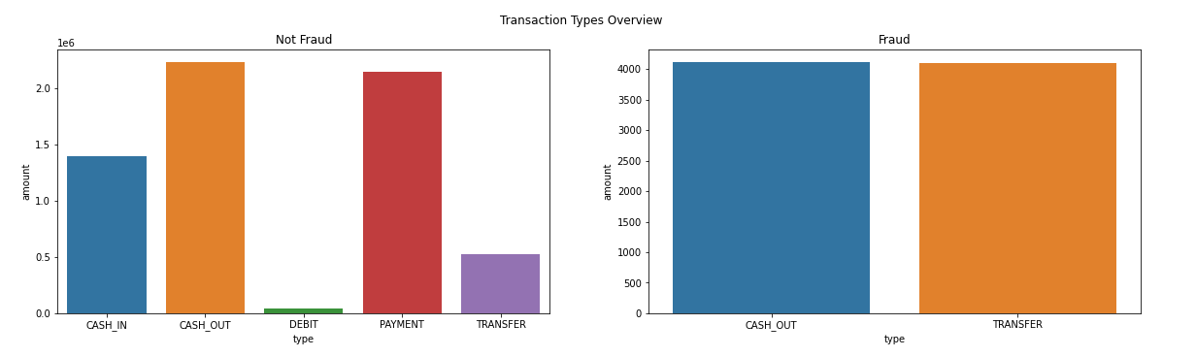
Exploratory Analysis - Type of Transaction
Type of transaction will be a very important variable for detecting fraudulent transactions since past fraud appears to only happen in cash out and transfer transactions.

Slide 6
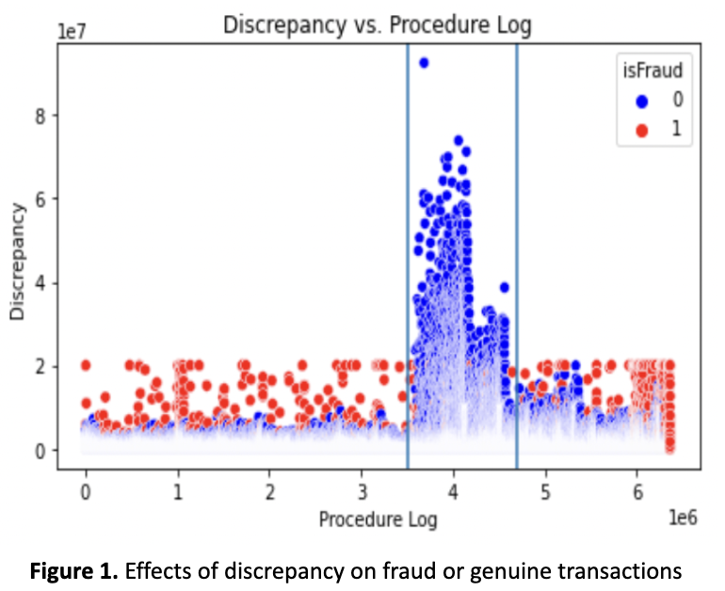
Exploratory Analysis - Errors in Balances
Out of the 2.8 million total cash-out and transfer transactions that occur, only about 0.3% are fraud.
The bank only classified 0.2% of fraudulent transactions as fraud.

Slide 7
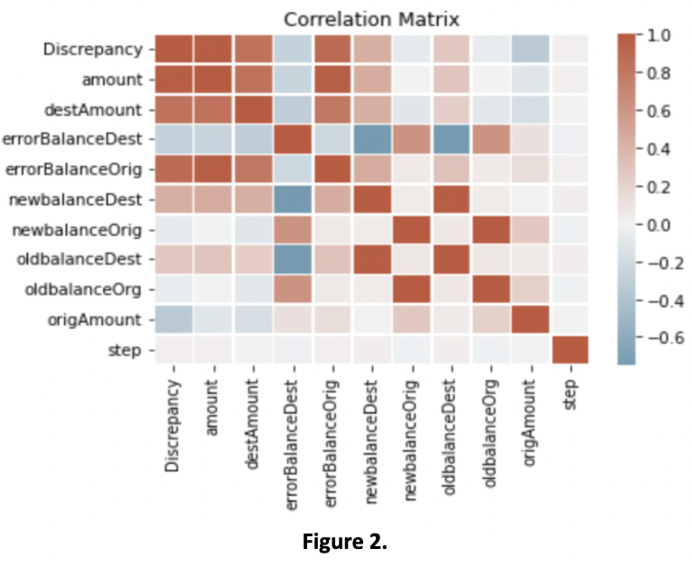
Exploratory Analysis - Multicollinearity
The balances before and after a transaction of the sender are highly correlated, which will have an impact on the variables chosen by lasso regression.
In addition, the balances before and after a transaction of the receiver are highly correlated.

Slide 8
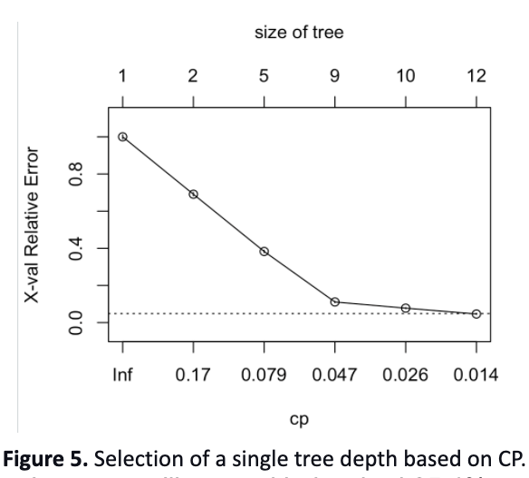
Single Decision Tree
Complexity parameter (CP) is used to control the size of the decision tree
Select the optimal tree size with 6 level depth

Slide 9
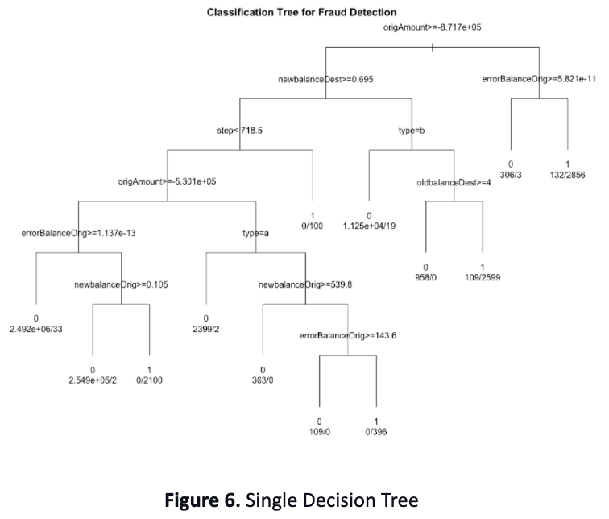
Single Decision Tree Graph
Sender’s balance before transaction
Receiver's balance after transaction
Error in Receiver’s balance

Slide 10
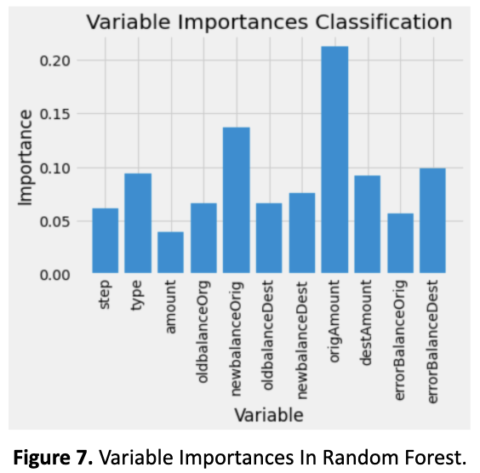
Random Forest
Create 500 decision trees and each with a maximum 6-level depth.
Under 0.5 cut-off, both classification rate and Out of Bag (OOB) Score are higher than 99% due to large true negative cases (genuine).
Sender’s balance before/after transaction
Error in Receiver’s balance

Slide 11
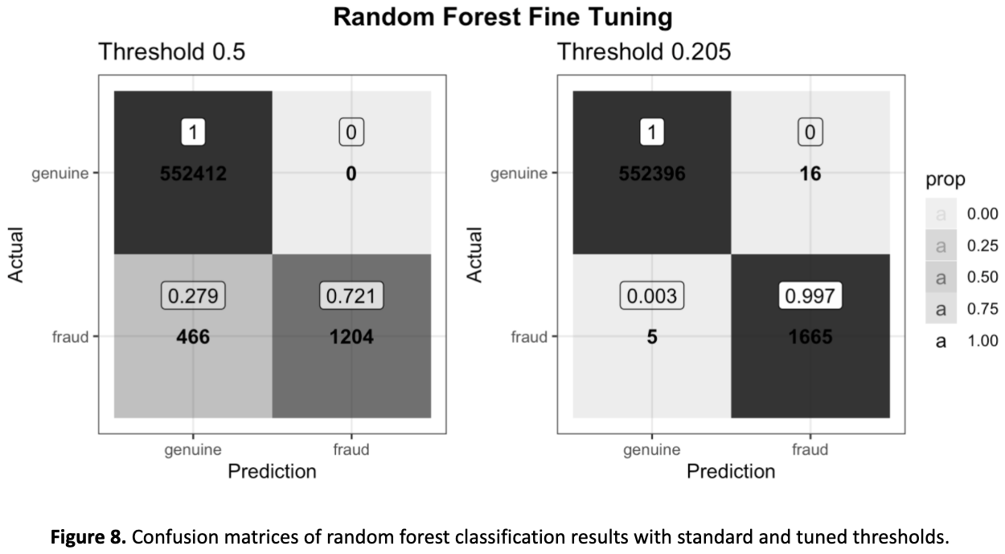
Random Forest Result
552412
0
552396
16
446
1204
5
1665

Slide 12
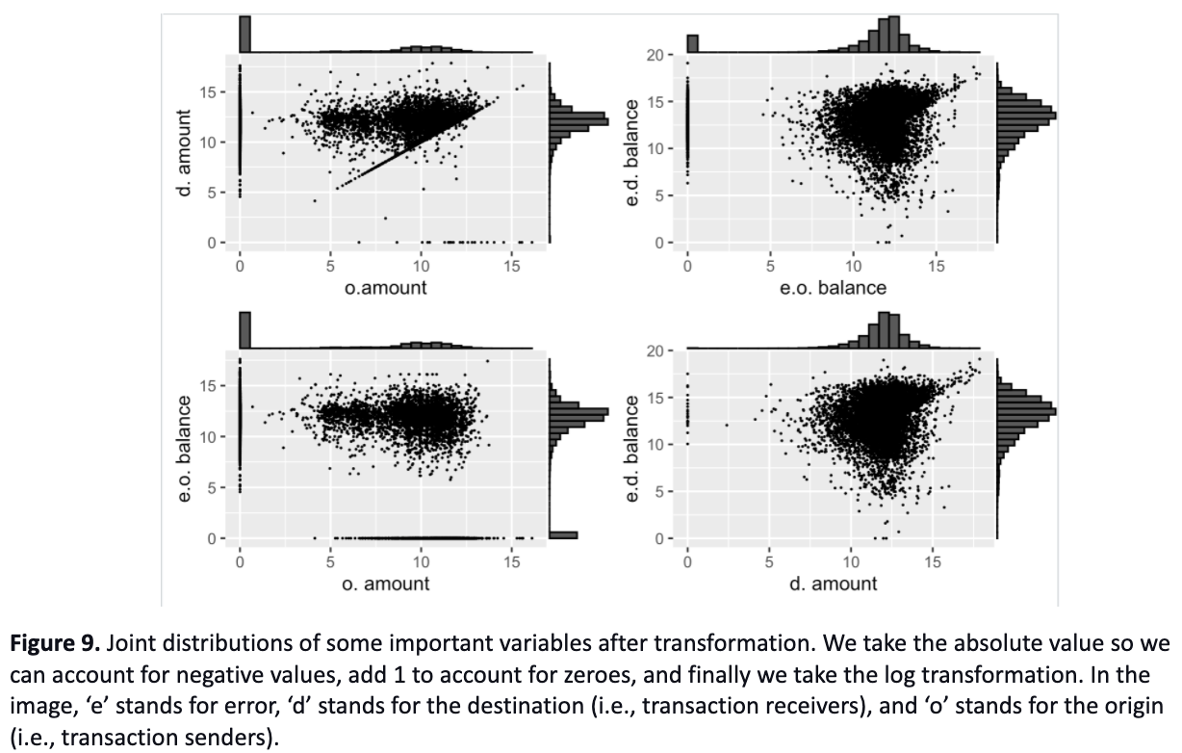
Logistic Regression - Variable Transformation
Previously, the distributions of some of the most important variables were highly skewed.
Transform them to reduce the impacts of outliers.

Slide 13
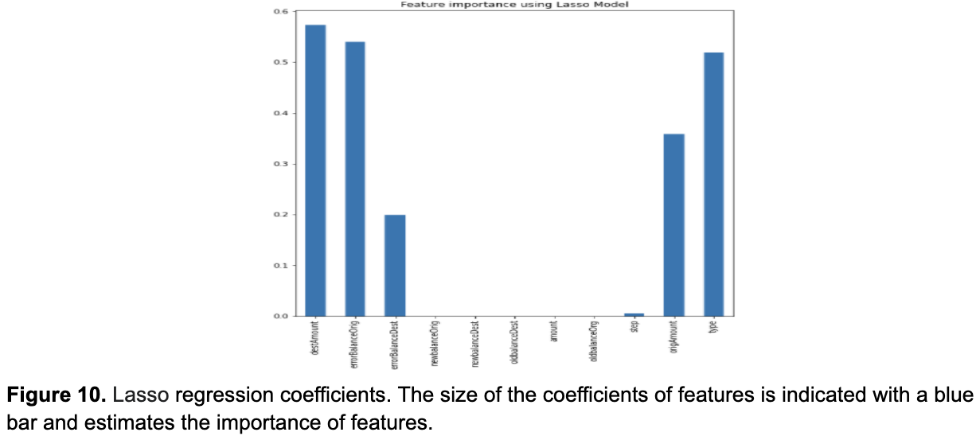
Logistic Regression - Variable Selection (Lasso)
Least absolute shrinkage and selection operator (Lasso)
Sender’s balance before transaction
Receiver's balance before transaction
Error in Sender’s balance
Type

Slide 14
Logistic Regression - Variable Selection (RFE)
Recursive feature elimination (RFE)
Select 8 features with the highest accuracy of 99.86%
Time
Type of transaction
Amount being transacted
Sender’s balance before/after transaction
Receiver's balance after transaction
Error in Sender’s balance
Error in Receiver’s balance

Slide 15
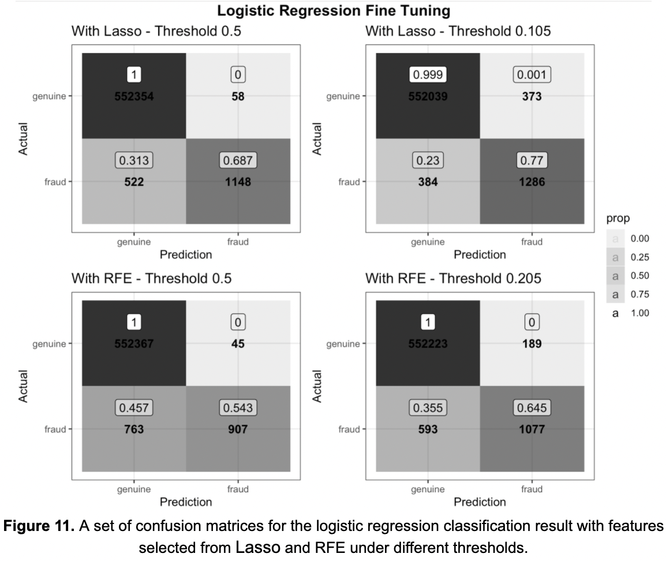
Logistic Regression - Results
552354
58
552039
373
522
1148
384
1286
552367
45
552223
189
763
907
593
1077

Slide 16
Conclusion
Lasso selects better set of predictors for logistic regression
Yet, random forest has better performance
Across all models, here are most significant predictors:
Sender’s balance before and after transaction
Receiver's balance after transaction
Error in Sender’s balance and Receiver’s balance

Slide 17
Reference
Fraudulent transaction definition reference: ​​https://www.creditcards.com/credit-card-news/glossary/term-fraudulent-transaction/
Data source: https://www.kaggle.com/ealaxi/paysim1
Paper reference: https://www.sciencedirect.com/science/article/abs/pii/S0065245820300851
Article reference:
https://www.businesswire.com/news/home/20200224005675/en/Juniper-Research-Online-Payment-Fraud-Losses-to-Exceed-200-Billion-Over-Next-5-Years
https://www.businesswire.com/news/home/20210323005370/en/Total-Identity-Fraud-Losses-Soar-to-56-Billion-in-2020
Methods reference: https://www.intellspot.com/anomaly-detection-algorithms/
Anomaly detection methods: https://towardsdatascience.com/anomaly-fraud-detection-a-quick-overview-28641ec49ec1
Variable Selection methods: Introduction to Statistical Learning pdf: https://web.stanford.edu/~hastie/ISLRv2_website.pdf

Slide 18
Q & A
Any questions?

Slide 19
Thank you
Zengxiaoran Kang, Kazy Atausha

